Slide 1
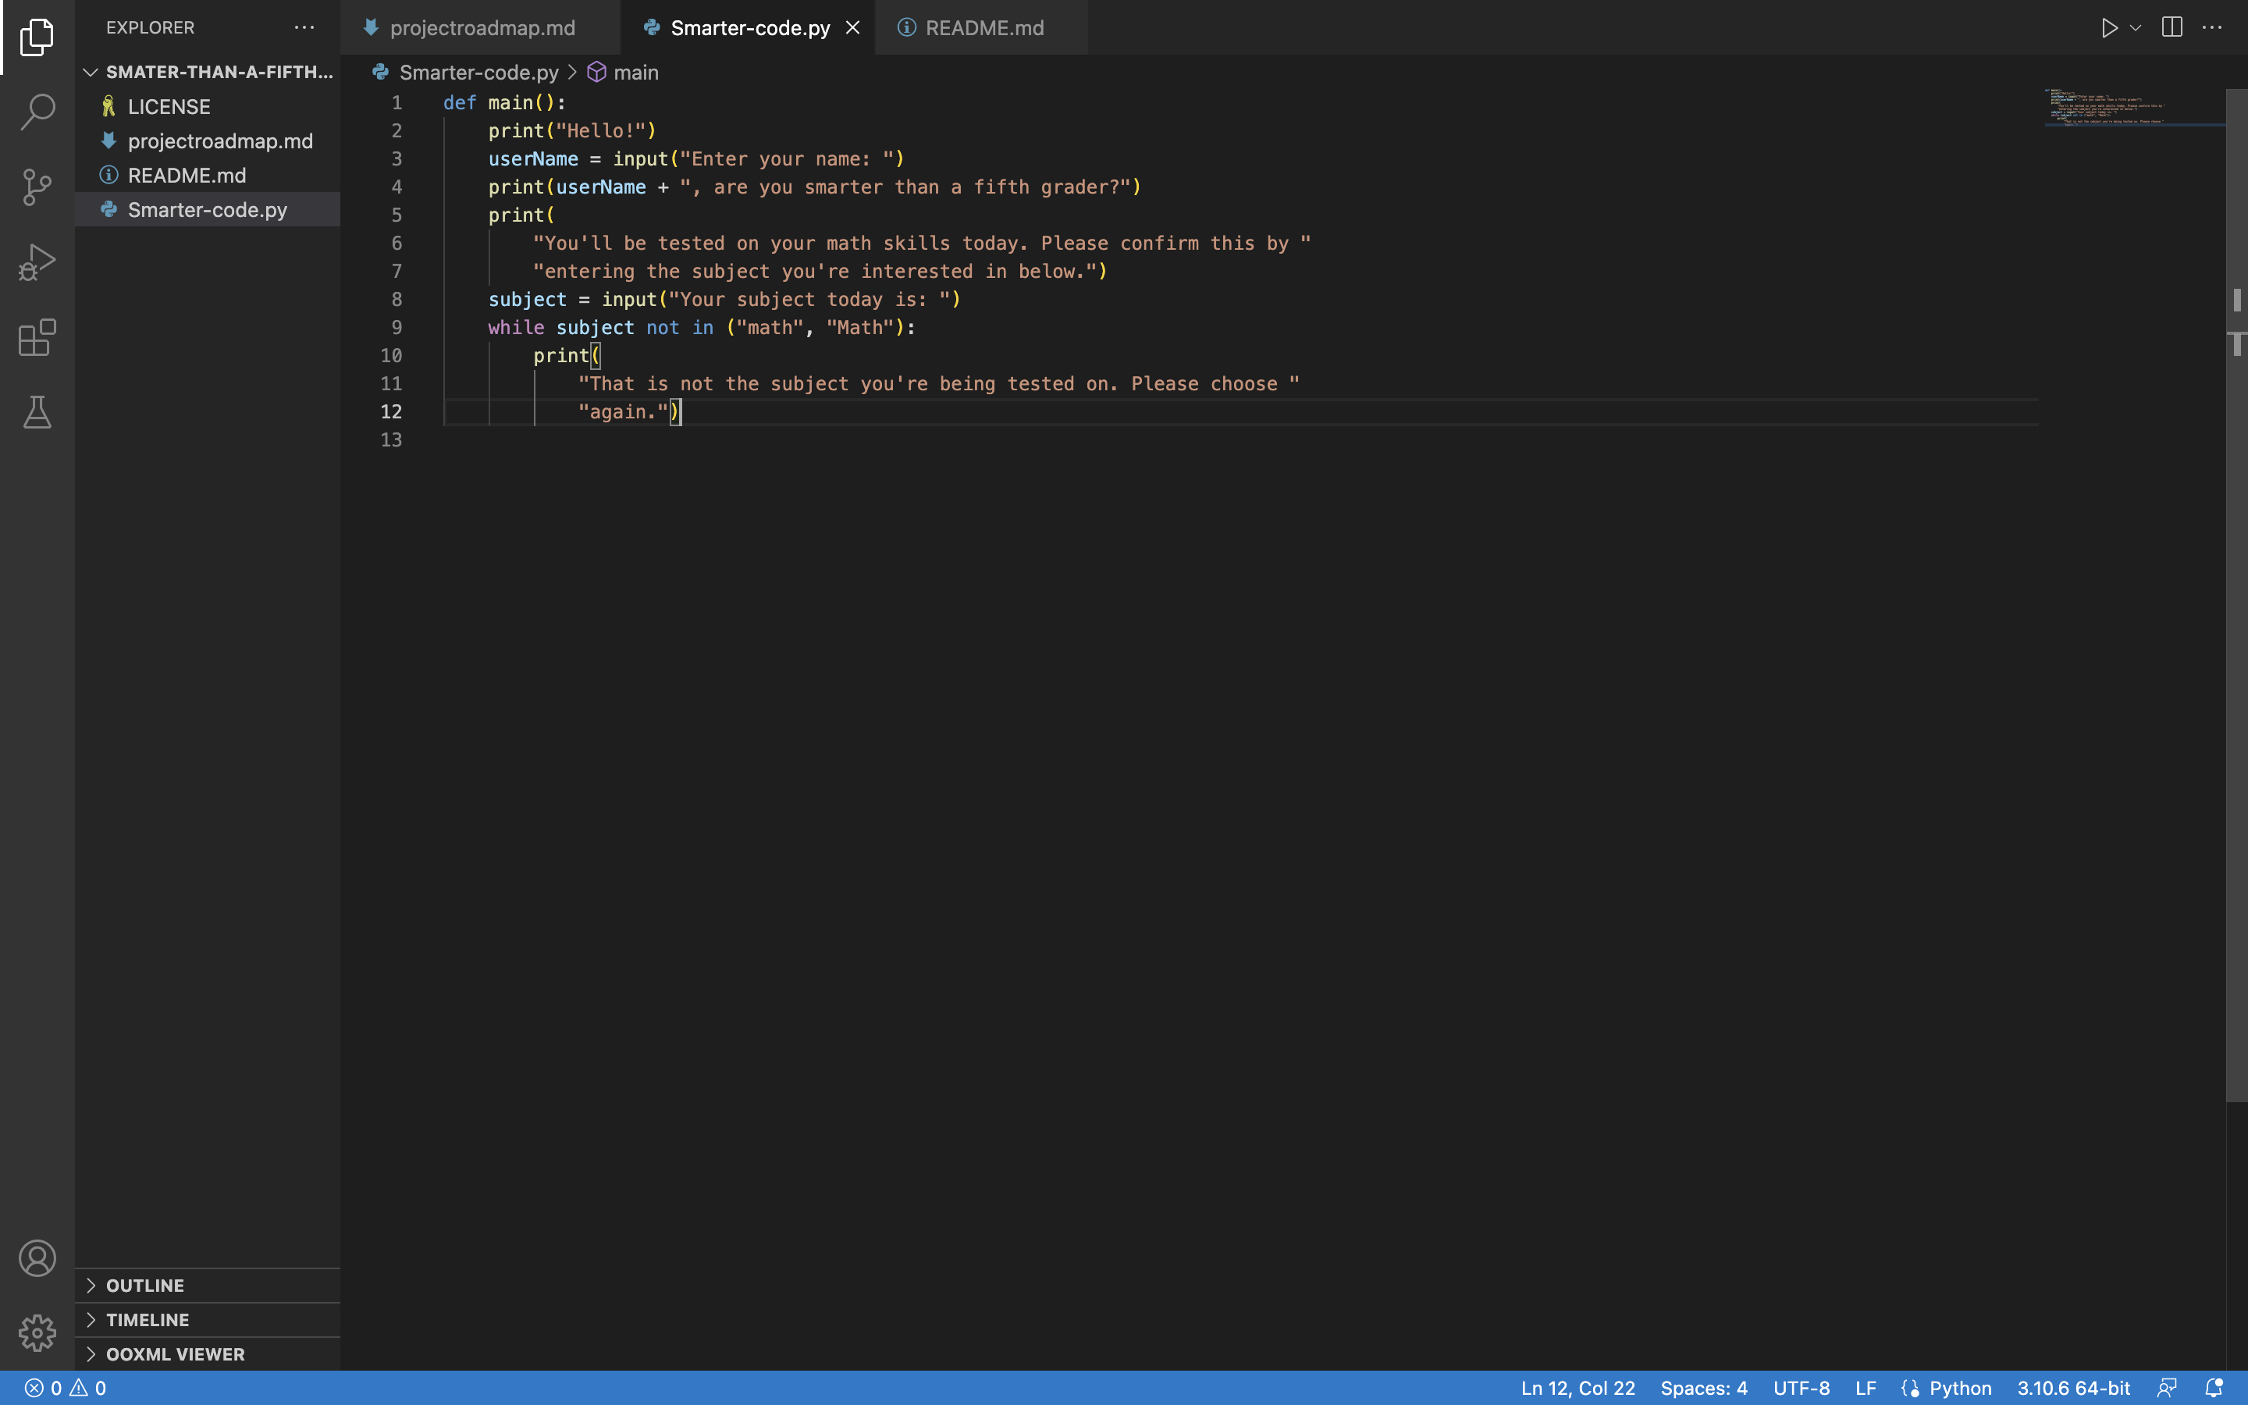

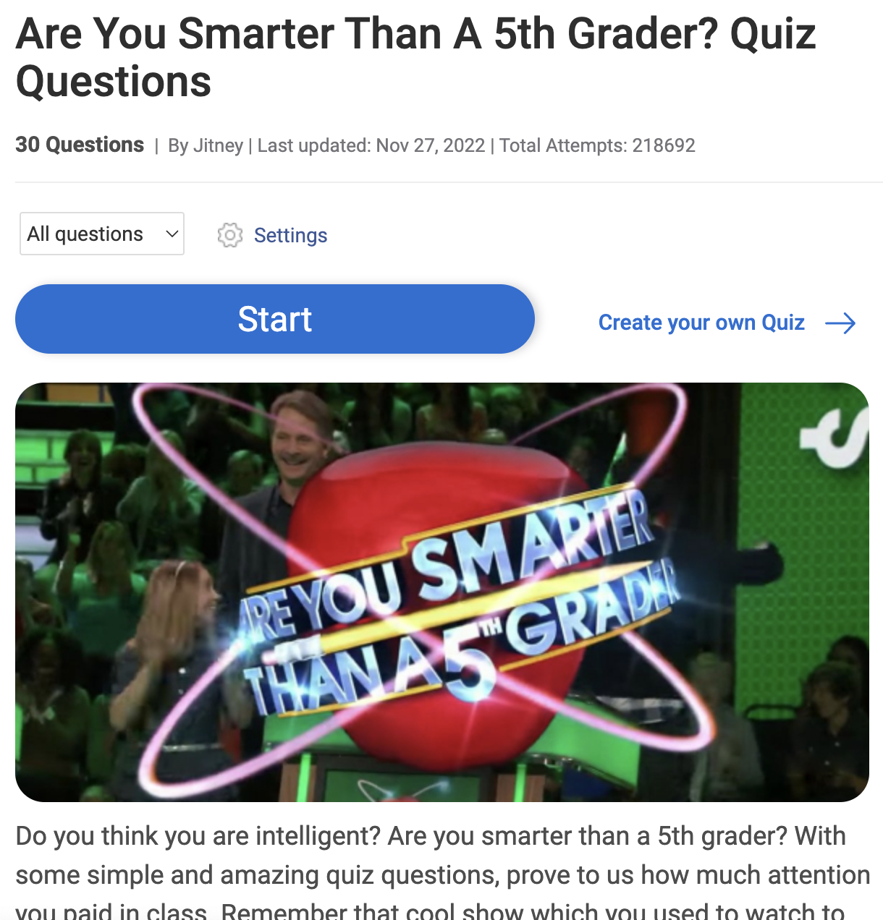
Are you smarter than a 5th grader?
https://github.com/ksu-is/Smater-than-a-fifth-grader
A quiz to test if users are smarter than a fifth grader.
Based on the game show: “Are you smarter than a fifth grader?”
Team member: Kailyn Callier

